Slide 1
18ECE220T- Unit 3- Multiple Input Multiple Output Systems

Slide 2
Introduction to MIMO Systems
MIMO is an antenna technology for wireless communications in which multiple antennas are used at both the source (transmitter) and the destination (receiver) .
The antennas at each end of the communications circuit are combined to minimize errors and optimize data speed. MIMO is one of several forms of smart antenna technology, the others being MISO (multiple input, single output) and SIMO (single input, multiple output).

Slide 3
Need for MIMO Systems
Modern wireless systems continue to demand higher data rates and better reliabilities.
These demands can be fulfilled using the conventional systems which are limited by multipath fading and interference by increasing either channel bandwidth, transmitted power, or both.
However, this simplistic solution is not attractive for the following reasons.
Firstly, transmitted power cannot exceed a certain value for its biological hazards and besides that, the sensitivity of wireless receivers rarely exceeds 30-35 dB because of the difficulty of building linear receivers at a reasonable cost.
Secondly, the frequency spectrum is a scarce resource especially below the 6 GHz.
This makes it very difficult and costly to increase the channel bandwidth.
For all these reasons, new techniques must be introduced to achieve these demands of the modern wireless systems. These techniques must be affordable in terms of cost and biologically unharmful.

Slide 4
MIMO System Model & its Performance
Receiver
Transmitter
•
•
•
•
•
•

Slide 5
Working Principle of MIMO
Traditional radio system either do nothing to combat multipath interference, relying on the primary signal to muscle out the interfering copies or employ mitigation techniques.
One technique uses a no. of antennas to capture the strongest signal at each moment in time. All techniques assume that the multipath signal is harmful and strive it to limit the damage.
On the contrary MIMO takes advantage of multipath propagation (direct and reflected signals).
MIMO uses multiple antennas to transmit multiple parallel signals.
In an urban environment, signals will bounce off trees, high rise buildings and reach the receiver through different path.
Receiver end uses an algorithm / DSP to sort out the multiple signals to produce one signal having originally transmitted data.
Multiple data streams are transmitted in a single channel at the same time and at the receiver multiple radios collect the multipath signal. ➢ MIMO OFDM uses IFFT in the transmitter and FFT in the receiver.
MIMO increase range, throughput and reliability.

Slide 6
Drawback of SISO System
In wireless system design, the most important part to understand and design is the wireless channel.
It is time-varying random filter which affects the capacity and successful transmission of information.
In ideal conditions, Shannon capacity of SISO channel depends upon available bandwidth (B), transmit power (P) and interference from noise (N).
In order to achieve maximum SISO capacity for SISO channel, we have to increase the B or P or reduce the noise level (N).
In practical systems we have limitations on B and P i.e. fixed available spectrum and power constraint.
Noise factor in wireless communication depends upon many factors including fading, shadowing, mobility of user and environment both. Hence we have a limited wireless capacity.

Slide 7
MIMO Features
Multiple-Input Multiple-Output (MIMO) system that improves the bandwidth efficiency and system reliability without the need to use extra bandwidth or transmitting more power into the channel.
In MIMO systems, the transmitter uses more than one antenna to transmit the data and the receiver uses more than one antenna to receive these data.
The capacities achieved by MIMO systems are very high compared with the conventional systems (SISO, SIMO, and MISO) given that the underlying channel is rich in scatterers with independent spatial fading.
This gain in capacity and reliability depends on the number of antennas on both sides, the statistics of the channel, and the channel knowledge at the transmitter bandwidth, at the same time and this is the source of capacity gain in spatial multiplexing based MIMO systems. This extra capacity is obtained without increasing the channel bandwidth or transmitted power.

Slide 8
MIMO Features
Capacity increases linearly with the increase of number of antennas.
Using MIMO system, parallel transmit streams of single user or multiple users can be sent and received.
Hence using these parallel sub-channels very high capacity can be achieved. It is then MIMO systems which will make giga-bit wireless systems a reality.

Slide 9
Benefits of MIMO Technology
The benefits of MIMO technology that help achieve such significant performance gains are
array gain, spatial diversity gain, spatial multiplexing gain and interference reduction
Array gain is the increase in receive SNR that results from a coherent combining effect of the wireless signals at a receiver.
The coherent combining may be realized through spatial processing at the receive antenna array and/or spatial pre-processing at the transmit antenna array.
Array gain improves resistance to noise, thereby improving the coverage and the range of a wireless network.
signal level at a receiver in a wireless system fluctuates or fades.
Spatial diversity gain mitigates fading and is realized by providing the receiver with multiple (ideally independent) copies of the transmitted signal in space, frequency or time.

Slide 10
Benefits of MIMO Technology
Number of copies is often referred to as the diversity order, the probability that at least one of the copies is not experiencing a deep fade increases, thereby improving the quality and reliability of reception.
A MIMO channel with M transmit antennas and N receive antennas potentially offers MN independently fading links, and hence a spatial diversity order of MN
MIMO systems offer a linear increase in data rate through spatial multiplexing, i.e., transmitting multiple, independent data streams within the bandwidth of operation.
In general, the number of data streams that can be reliably supported by a MIMO channel equals the minimum of the number of transmit antennas and the number of receive antennas, i.e., min(M, N).
The spatial multiplexing gain increases the capacity of a wireless network.
Interference in wireless networks results from multiple users sharing time and frequency resources.
Interference may be mitigated in MIMO systems by exploiting the spatial dimension to increase the separation between users.

Slide 11
Basic Block diagram of MIMO System

Slide 12
Outage capacity and multiplexing gain
The capacity of a communication channel is the maximum, error-free transmission rate that can be achieved. The capacity of a MIMO channel is a complicated function of the channel conditions and transmit/receive processsing constraints.
The p percentage outage capacity at SNR ρ, Cout,p(ρ), is defined as the transmission rate that can be supported by (100−p)% of the fading realizations of the channel.
Hence at SNR , if a frame is transmitted with rate Cout,p (ρ), the probability that the frame will be decoded correctly is (100−p)%.

Slide 13
Multiplexing gain
The maximum multiplexing gain rmax that can be achieved over a MIMO channel is given by the asymptotic (in SNR) slope of the outage capacity (for fixed FER) plotted as a function of the SNR on a linear–log scale, i.e.,

Slide 14
Diversity gain
The maximum diversity gain dmax that can be achieved over a MIMO channel is given by the negative of the asymptotic (in SNR) slope of FER for a fixed transmission rate, plotted as a function of SNR on a log–log scale, i.e.,

Slide 15
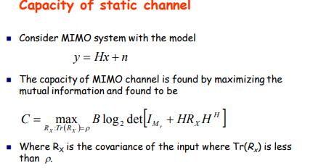
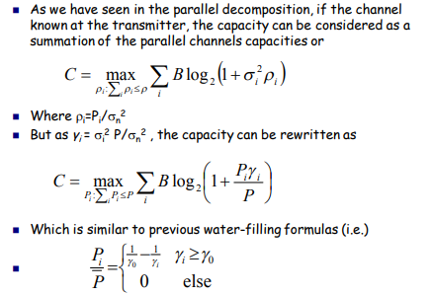
Capacity of MIMO Channels

Slide 16
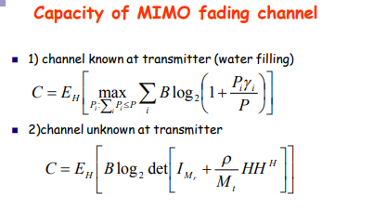
Capacity of MIMO Channels

Slide 17
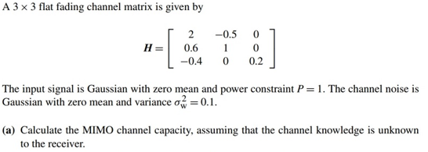
Problem – 1:

Slide 20
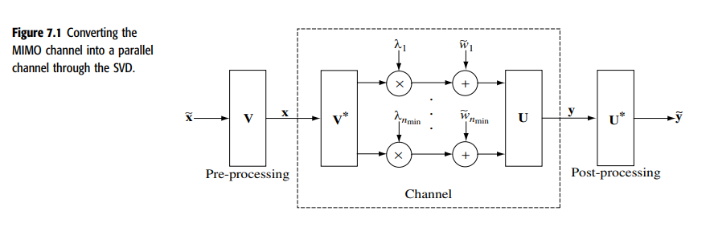

Slide 27

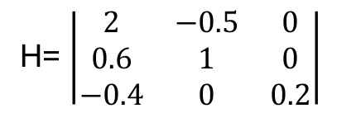
Problem – 2:
(a) Find the capacity of this channel.
H= $\left|\begin{matrix}2 & −0.5 & 0 \\ 0.6 & 1 & 0 \\ −0.4 & 0 & 0.2\end{matrix}\right|$

Slide 31
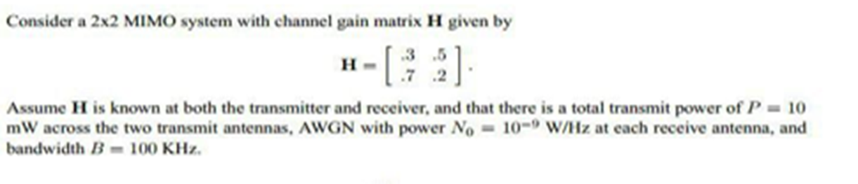
Problem – 3:
(a) Find the SVD for H

Slide 35
Spatial Multiplexing
Spatial multiplexing or space-division multiplexing (SM, SDM or SMX) is a multiplexing technique in MIMO wireless communication, fibre-optic communication and other communications technologies used to transmit independent channels separated in space.
Spatial multiplexing: This form of MIMO is used to provide additional data capacity by utilizing the different paths to carry additional traffic, i.e. increasing the data throughput capability.
Spatial multiplexing is a MIMO wireless protocol that sends separate data signals or streams between antennae to enhance wireless signal performance or functionality. It is a type of “spatial diversity” and an engineering trick that helps to increase the possibilities for various types of end-to-end transmission.
Spatial multiplexing takes advantage of the differences in the channels between transmitting and receiving antenna pairs to provide multiple independent streams between the transmitting and receiving antennas, increasing throughput by sending data over parallel streams.

Slide 36
Spatial Multiplexing
SM uses singular value decomposition (SVD)
SVD decomposes the channel into multiple streams, where the number is the smaller of the number of transmitting or receiving antennas. For scenarios such as 2x2 or 4x2 MIMO, for example, SVD can generate two independent streams, while for 4x4 (four transmit antennas and four receive antennas), it can generate four streams, potentially quadrupling the throughput.

Slide 37
Spatial Multiplexing
In practice, the actual throughput will depend on how high of an SINR can be achieved in each of the streams.
Using the SVD technique, Wireless InSite generates orthogonal data streams and computes the effective SINR for each, allowing it to predict the throughput for each parallel stream.
Users can choose between uniform power allocation or waterfilling to improve how power is applied to streams and can request that the model drop poorly performing streams to achieve the combination of power-splitting and streams that provide the best overall throughput.
Total throughput from a channel is then calculated from the sum of throughput from all parallel streams.

Slide 38
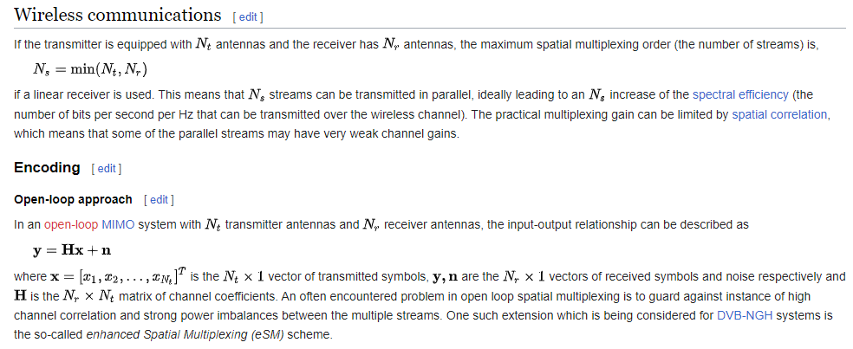
Spatial Multiplexing

Slide 39
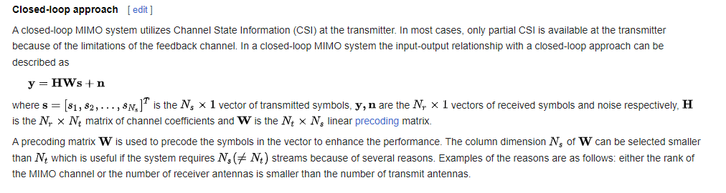
Spatial Multiplexing

Slide 40
Spatial diversity
Spatial diversity used in this narrower sense often refers to transmit and receive diversity. These two methodologies are used to provide improvements in the signal to noise ratio and they are characterized by improving the reliability of the system with respect to the various forms of fading.
As a result of use of multiple antennas, MIMO wireless technology is able to considerably increase the capacity of a given channel while still obeying Shannon's law. By increasing the number of receive and transmit antennas it is possible to linearly increase the throughput of the channel with every pair of antennas added to the system.
This makes MIMO wireless technology one of the most important wireless techniques to be employed in recent years. As spectral bandwidth is becoming an ever more valuable commodity for radio communications systems, techniques are needed to use the available bandwidth more efficiently. MIMO wireless technology is one of these techniques.

Slide 41
Spatial diversity
Two significant advantages of MIMO over SISO/ MISO are as given below:-
1. In MIMO, there is a significant increase in the system’s capacity and spectral efficiency. The capacity of a wireless link increases linearly with the minimum of the number of transmitter or receiver antennas.
The data rate can be increased by spatial multiplexing without consuming more frequency resources and without increasing the total transmit power.
2. In MIMO, there is a dramatic reduction of the effects of fading due to the increased diversity. This is particularly beneficial when the different channels fade independently.

Slide 42
V-BLAST Architecture
The constant demand for improved capacity, higher data rates and quality of service, QoS has led to an appreciation of the probable capacity gains possible using the MIMO systems.
There are many schemes that can be applied to MIMO systems such as space time block codes, space time trellis codes, and the Vertical Bell Labs Space-Time Architecture (V-BLAST).
The data stream is split into multiple sub-streams and an array of antennas is used to transmit the parallel sub-streams. All the sub-streams are transmitted in the same frequency band which allows the spectrum to be used very efficiently

Slide 43
V-BLAST Architecture
V-BLAST (Vertical-Bell Laboratories Layered Space-Time) is a detection algorithm to the receipt of multi-antenna MIMO systems. Available for the first time in 1996 at Bell Laboratories in New Jersey in the United States by Gerard J. Foschini. He proceeded simply to eliminate interference caused successively issuers.
Its principle is quite simple: to make a first detection of the most powerful signal.
It regenerates the received signal from this user from this decision. Then, the signal is regenerated subtracted from the received signal and, with this new signal, it proceeds to the detection of the second user's most powerful, since it has already cleared the first and so forth. What gives a vector containing received less interference.

Slide 44
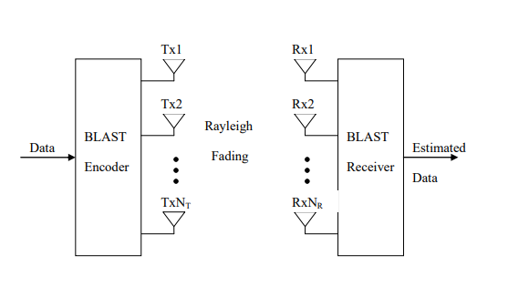
A Typical BLAST Configuration
The BLAST system can be envisaged in different configurations. The most popular are: diagonal, D-BLAST; horizontal, H-BLAST; vertical, V-BLAST; and TURBO-BLAST

Slide 45
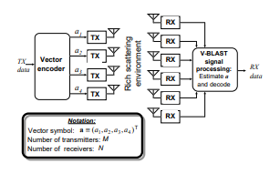
A Typical VBLAST
A high-level block diagram of a BLAST system is shown in Fig. 1. A single data stream is demultiplexed into M substreams, and each substream is then encoded into symbols and fed to its respective transmitter.
Transmitters 1 − M operate cochannel at symbol rate 1/ T symbols/sec, with synchronized symbol timing. Each transmitter is itself an ordinary QAM transmitter.
The collection of transmitters comprises, in effect, a vector-valued transmitter, where components of each transmitted M-vector are symbols drawn from a QAM constellation. We assume that the same constellation is used for each substream, and that transmissions are organized into bursts of L symbols.
The power launched by each transmitter is proportional to 1/ M so that the total radiated power is constant and independent of M.

Slide 46
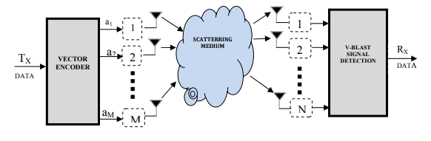
A Typical VBLAST
A data stream is demultiplexed into M sub-streams termed layers. The layers are arranged horizontally across space and time for V-BLAST and the cycling operation is removed before transmission is shown in Fig.
At the receiver, as mentioned previously, the received signals at each receive antenna is a superposition of M faded symbols plus additive white Gaussian noise (AWGN).
Although the layers are arranged differently for the two BLAST systems across space and time, the detection process for both systems is performed vertically for each received vector. Without loss of generality, assume that the first symbol is to be detected.

Slide 47
V-BLAST Transmitter
The incoming data stream to be transmitted is normally split into separate sub-streams where each sub-stream experiences independent encoding algorithms before being directed towards the input of a transmitting antenna.
This form of layering when compared to the diagonal nature of D-BLAST is horizontal in nature which simply implies that the constituent symbols of one of the sub-streams are all evident on and transmitted using the same antenna.

Slide 48
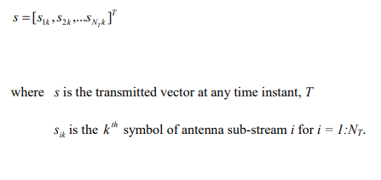
V-BLAST Transmitter
This form of layering would almost certainly remove the space wastage problem realized by the D-BLAST detector though it already gives an immediate drawback in the loss of transmit diversity normally exhibited by the D-BLAST receiver since the symbols of every subsequent sub-stream are not spread across all the transmit antennas.
The transmitted symbol array can be envisaged as shown below.

Slide 49
V-BLAST Transmitter
It achieves high spectral efficiencies by spatially multiplexing coded or uncoded symbols over the MIMO fading channel. Symbols are transmitted through M antennas.
Each receiver antenna receives a superposition of faded symbols.

Slide 50
V-BLAST Receiver
The nature of the V-BLAST layering is such that the symbols are transmitted in a vector manner with each incident vector comprising a symbol from each sub-stream.
In systems where a form of channel coding is utilized, the received symbols need to be stored in a data buffer until the adequate block size required for correct demodulation has been received.
V-BLAST requires a detector to approximate the initial incident transmitted arrays before final signal detection.

Slide 51
V-BLAST Receiver
The detection process consists of two main operations:
I) Interference suppression (nulling): The suppression operation nulls out interference by projecting the received vector onto the null subspace (perpendicular subspace) of the subspace spanned by the interfering signals. After that, normal detection of the first symbol is performed.
II) Interference cancellation (subtraction): The contribution of the detected symbol is subtracted from the received vector.

Slide 52
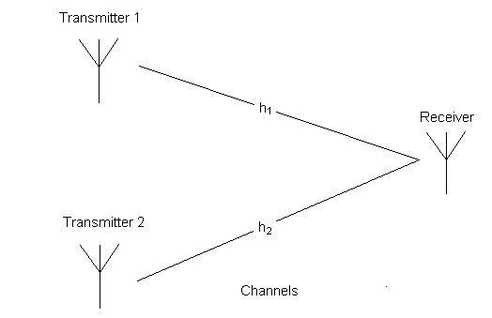
Alamouti code
To introduce Space Time Block Codes, we present The Alamouti code, an early space time code and still one of the most commonly used.
In this page, we discuss Alamouti code for 2 transmitters-1receiver system(2x1) and 2transmitters-2receivers system(2x2).

Slide 53
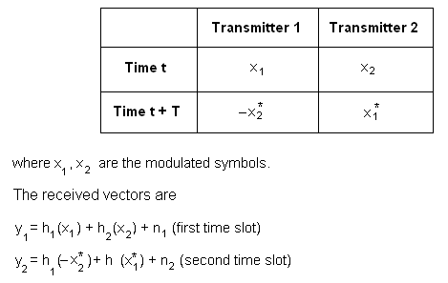
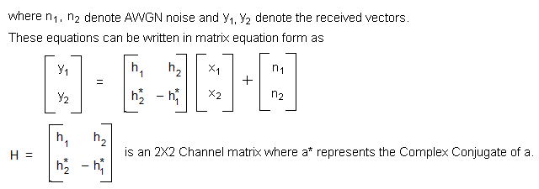
Alamouti code
Encoding is done in the following manner:

Slide 54
MIMO – OFDM
The demand for increased channel capacity in wireless and mobile communication has been rapidly increasing due to multi fold increase in demands of mobile data and multimedia services.
High data rate are provided by WLAN, WiMax and LTE/ LTE-Advanced (LTE-A).
Developing a wireless system with more spectral efficiency under varying channel condition is a key challenge to provide more bit rates with limited spectrum. MIMO system with OFDM gives higher gain by using the direct and the reflected signals, thus facilitating the transmission at high data rate.
Efficient implementation of MIMO-OFDM system is based on IFFT/FFT algorithm and MIMO encoding. The industry standards of LTE/LTE-A have also been taken up in this paper

Slide 55
MIMO – OFDM
The combination MIMO-OFDM is beneficial since OFDM enables support of more antennas and larger bandwidths since it simplifies equalization dramatically in MIMO systems.
By adopting Multiple-Input Multiple-Output (MIMO) and Orthogonal Frequency-Division Multiplexing (OFDM) technologies, indoor wireless systems could reach data rates up to several hundreds of Mbits/s and achieve spectral efficiencies of several tens of bits/Hz/s, which are unattainable for conventional single-input single-output systems.
The enhancements of data rate and spectral efficiency come from the fact that MIMO and OFDM schemes are indeed parallel transmission technologies in the space and frequency domains, respectively.
MIMO-OFDM when generated OFDM signal is transmitted through a number of antennas in order to achieve diversity or to gain higher transmission rate then it is known as MIMOOFDM. Efficient implementation of MIMO-OFDM system is based on the Fast Fourier Transform (FFT / IFFT) algorithm and MIMO encoding, such as Alamouti Space Time Block coding (STBC), the Vertical Bell-Labs layered Space Time Block code VBLASTSTBC, and Golden Space-Time Trellis Code (Golden STTC) [3].

Slide 56
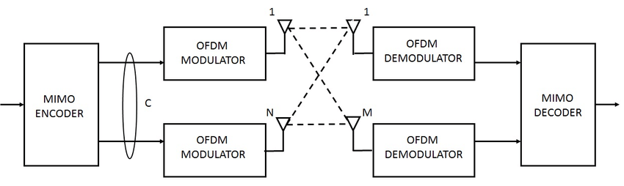
MIMO OFDM SYSTEM MODEL

Slide 57
MIMO – OFDM
OFDM has been adopted for various transmission systems such as Wireless Fidelity (WIFI), Worldwide Interoperability for Microwave Access (WIMAX), Digital Video Broadcasting (DVB) and Long Term Evolution (LTE). The OFDM system assigns subgroups of subcarriers to each user.
With thousands of subcarriers, each user would get a small percentage of the carriers. In a modern system like the 4G LTE cellular system, each user could be assigned from one to many subcarriers. In LTE, subcarrier spacing is 15 kHz. Using a 10-MHz band, the total possible number of subcarriers would be 666. In practice, a smaller number like 512 would be used.
If each subscriber is given six subcarriers, we can place 85 users in the band. The number of subcarriers assigned will depend on the user’s bandwidth and speed needs. Combining OFDM with multiple input multiple output (MIMO) technique increases spectral efficiency to attain throughput of 1 Gbit/sec and beyond, and improves link reliability.

Slide 58
Industry standards issued for various services
The IEEE 802.11n WLAN standards provides a series of enhancement technique to both the physical layer and MAC layers leading throughput of up to 100 Mbps.
The standards include MIMO – OFDM technology and 40 MHz operation to the physical layer. 802.11n operates on both the 2.4 GHz and the lesser used 5 GHz bands.
Support for 5 GHz bands is optional. It operates at a maximum net data rate from 54 Mbit/s to 600 Mbit/s.
The IEEE has approved the amendment and it was published in October 2009. Prior to the final ratification, enterprises were already migrating to 802.11n networks.

Slide 59
IEEE 802.16a for WiMAX
IEEE 802.16a for WiMAX standards Wi-Max is used to provide broadband wireless connectivity over a substantial geographical area such as large metropolitan city.
It has been designed to evolve a set of air interfaces based on a common MAC protocol but physical layer specifications having an air interface support in 2-11 Ghz band having both licensed and license exempt spectrum.
Wi Max can use radio bandwidth that can vary from 1.25 MHz to 28 MHz in steps of 1.75 MHz in 2GHz to 11 GHz band. It also uses multicarrier OFDMA scheme with MIMO antenna technique to achieve transmission data rate as high as 155 Mbps.
WiMAX equipment can operate in different FDD or TDD configuration and operate in different frequency bands of 5.8 GHz, 3.5 GHz and 2.5 GHz.

Slide 60
LTE/ LTE Advanced Long Term Evolution (LTE)
LTE/ LTE Advanced Long Term Evolution (LTE) is a 4G wireless broadband technology developed by the Third Generation Partnership Project (3GPP), an industry trade group. 3GPP engineers named the technology "Long Term Evolution" because it represents the next step (4G) in a progression from GSM, a 2G standard, to UMTS, the 3G technologies based upon GSM.
LTE provides significantly increased peak data rates, with the potential for 100 Mbps downstream and 50 Mbps/ 30 Mbps upstream, reduced latency, scalable bandwidth capacity, and backwards compatibility with existing GSM and UMTS technology.
In LTE advanced - 4G, max down link speed of 1 Gbps and beyond is expected in future. The upper layers of LTE are based upon TCP/IP, which will likely result in an all-IP network similar to the current state of wired communications. LTE will support mixed data, voice, video and messaging traffic.

Slide 61
LTE – OFDM & MIMO
LTE uses OFDM (Orthogonal Frequency Division Multiplexing) and MIMO (Multiple Input Multiple Output) antenna technology. The higher signal to noise ratio (SNR) at the receiver enabled by MIMO, along with OFDMA and SCFDMA (Single channel orthogonal frequency division multiple access in up link), provides improved coverage and throughput, especially in dense urban areas.
LTE 4G network will compete with WiMAX for both enterprise and consumer broadband wireless customers.
Outside of the US telecommunications market, GSM is the dominant mobile standard, with more than 80% of the world's cellular phone users.
As a result, HSDPA and then LTE are the likely wireless broadband technologies of choice for most users.
Nortel and other infrastructure vendors are focusing significant research and development efforts on the creation of LTE base stations to meet the expected demand. When implemented, LTE has the potential to bring pervasive computing to a global audience, with a wire-like experience for mobile users everywhere. A comparison between 3G (WCDMA), HSPA, HSPA+, LTE and LTE advanced is given on the next page.

